Slide 1
C++ programming basics
Notes for C++ programming basics by Daipayan Bhowal

Slide 2
Overview
Topics to discuss:-
C/C++ compiler stages
Why C++ is a hybrid language ?
Real world usage of OOPs
What are Classes & Objects ?
Constructor & destructor
Default arguments & initializer list
References as an alternative to pointer
Difference between Call by reference & Call by address
Difference between #define and const
const member functions
Inline functions and conditions
Difference between MACRO functions and inline functions
Inheritance and their types
public, private and protected
Deathly Diamond problem
this pointer
‘virtual’ keyword and usage
Vptr and VTable
virtual destructor
State Machine using Run-time polymorphism
Function overloading/Compile time polymorphism
Name Mangling in C++
Namespace and anonymous namespace
Scope resolution operator
New datatypes
Pure function
Difference between Memory management in C & C++
Difference between C and C++
Undefined behaviour in C/C++

Slide 3
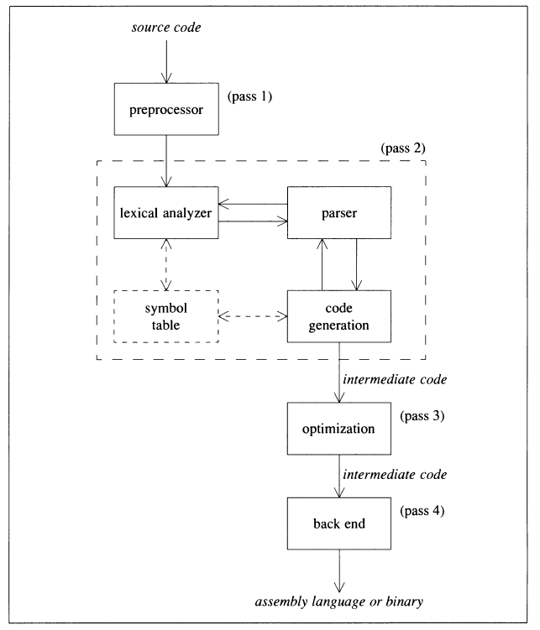
C/C++ compiler stages

Slide 4
C++ as a hybrid language
Why C++ is called a hybrid language ?
C++ is a hybrid not because it allows one to write C-style code, but because it supports several programming paradigms, such as procedural, object-oriented, and generic. C++ does not force you into one way of doing things, and that is its strength, making it more flexible.

Slide 5
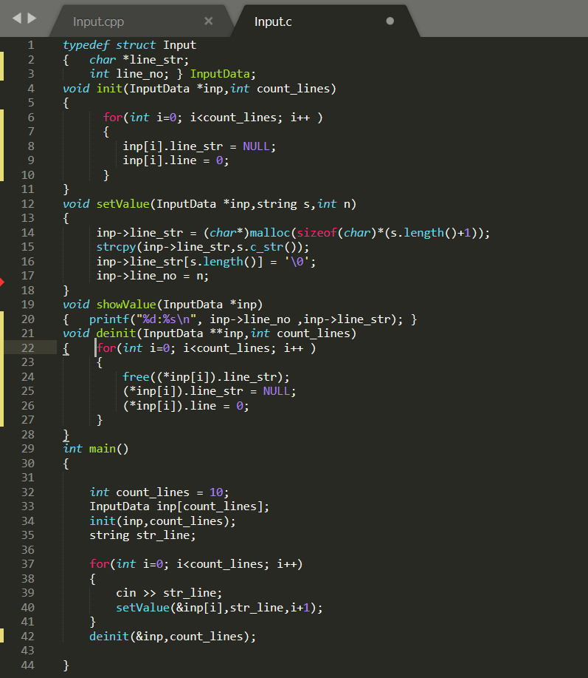
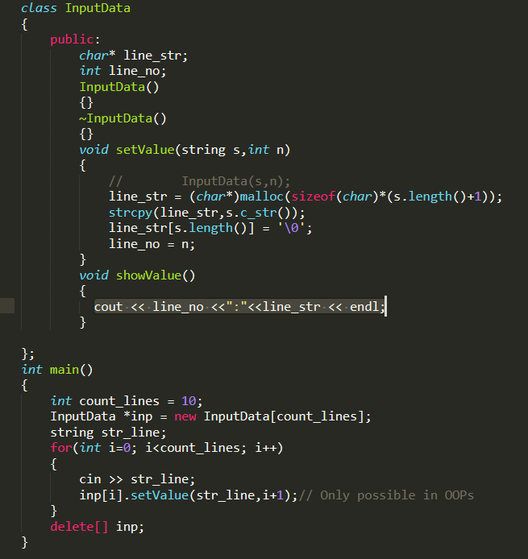
Real world usage of OOPs
Class & Objects enables us to do operations on real world entity which was not possible previously in procedural code, here binding of data and methods is possible due to OOPs a C++ code with equivalent C code given below:-

Slide 6
Classes and Objects
Structures provides a method for packing together data of different types.
struct student { char name[20] ; int ro11_number; float total_marks; };
Limitations of structures: The standard C does not allow the struct data type to be treated like built-in types.
Another important limitation of C structures is that they do not permit data hiding. For example, consider the following structure:
struct complex
{
float x;
float y;
} cl, c2, c3;
c3 = c1 + c2; is illegal in C.
A class is a way to bind the data and its associated functions together. It also allows the data and functions to be hidden.
class item
( int number; // private by default
float cost;
public:
void getdata(int a, float b):
void putdata(void);
}; In C++, the class variables are known as objects, ex:- x is called an object of type item item x;

Slide 7
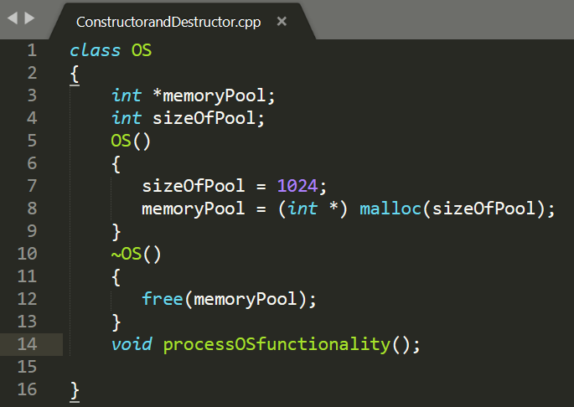
Constructor & Destructors
A constructor is a member function of a class which initializes objects of a class.
Constructor is automatically called when object(instance of class) create. i.e. OS o = OS(); here the operating system is asking for memory when it is bringing itself up/booting time. Destructor is a member function which destructs or deletes an object, when we are shutting down the OS then destructor will automatically free the allocated memory.
Conditions for Constructors & destructors
Constructor/Destructors has same name as the class itself
Constructors/Destructors don’t have return type
A constructor is automatically called when an object is created.
A destructor is automatically called when function/program/block ends.
A destructor is automatically called when delete operator is called.

Slide 8
Default Arguments & Initializer List
C++ allows us to call a function without specifying all its arguments A default argument is checked for type at the time of declaration and evaluated at the
time of call. One important point to note is that only the trailing arguments can have default
values and therefore we must add defaults from right to left.
int mul(int i,int j,int k=10) // Legal
int mul(int i=5,int j) // Illegal
int mul(int i=5,int j,int k=10) // Illegal
int mul(int i=5,int j=2,int k=10) // Legal
Initializer list is used to initialize data members, it can be used in Constructors and functions definition.
OS(): sizeOfPool(1024),memoryPool(NULL)
{ memoryPool = (int*) malloc(sizeOfPool);
}

Slide 9
Reference Variable
A reference variable provides an alternative name for a previously defined variable.
Both the variables refer to the same data object in the memory. Hence, change in the value of one will also be reflected in the value of the other variable.
Syntax:-
data-type & reference-name = variable-name
float total = 100;
float & sum = total;
cout << total;
cout << sum;

Slide 10
Difference between Call by reference and Call by Address
C++ permits us to pass parameters to the functions by reference. When we pass arguments the reference. the formal arguments in the called
function become aliases to the actual arguments in the calling function. void swap( int &a, int &b) // a and b are reference variables
{
int t = a;
a = b;
b = t;
}
swap(m,n);
In traditional C, this is accomplished using pointer and indirection as follows:
void swap1( int *a, int *b) /* Function definition */
{
int t;
t = *a;
*a = *b;
*b = t;
}
swap1{&x, &y); /* addresses of variables are passed */
This is called call by address as addresses are passed

Slide 11
Difference between #define and const
#define is a pre-processor directive. Things defined by #define are replaced by the preprocessor before compilation begins.
const variables are actual variables like other normal variable.
The big advantage of const over #define is type checking.
#define DIV(a,b) a / b
printf("25 / (3+2) = %d", DIV(25,3+2));
o/p:- 10, not 5 because the preprocessor will expand it this way:
printf("25 / (3+2) = %d", 25 / 3 + 2);
Safer version:-
#define DIV(a,b) (a) / (b)

Slide 12
Const member functions
A "const function", denoted with the keyword const after a function declaration, makes it a compiler error for this class function to change a member variable of the class. However, reading of a class variables is okay inside of the function, but writing inside of this function will generate a compiler error.
#include<iostream>
using namespace std;
class Test {
int value;
public:
Test(int v = 0) {value = v;}
// We get compiler error if we add a line like "value = 100;" in this function.
int getValue() const {return value;}
};
int main() {
Test t(20);
cout<<t.getValue();
return 0;
}

Slide 13
Inline functions and conditions
C++ proposes a new feature called inline function to eliminate the cost of calls to small functions The compiler replaces the function call with the corresponding function code (something similar to macros expansion).
inline double cube(double a} (return(a*a*a);}
Some of the situations where inline expansion may not work are:
1. For functions returning values, if a loop, a switch, or a goto exists.
2. For functions not returning values, if a return statement exists.
3. If functions contain static variables.
4. If inline functions are recursive.
5. the benefits of inline functions may be lost as the function grows in size.

Slide 14
Difference between MACRO functions and inline functions
The basic difference between inline and macro is that an inline functions are parsed by the compiler, whereas the macros in a program are expanded by preprocessor.
#define max(a,b) \
{ __typeof__ (a) _a = (a); \
__typeof__ (b) _b = (b); \
_a > _b ? _a : _b; }
__attribute__((always_inline)) int max(int a, int b)
{
return (a > b ? a : b);
}
Note: inline is just a request to the compiler that could be ignored
A macro on the other hand, is expanded by the preprocessor before compilation.

Slide 15
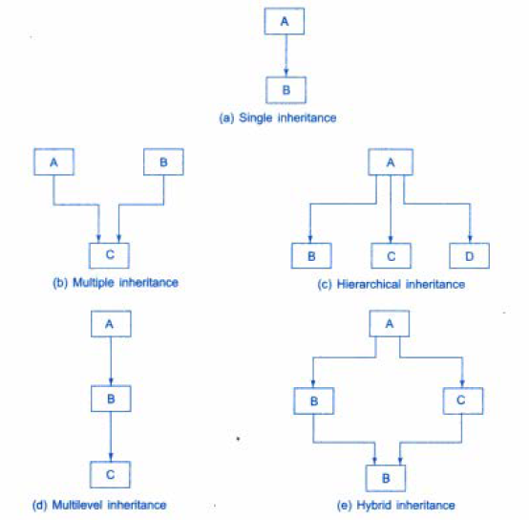
Inheritance and their types
The mechanism of deriving a new class from an old one is called inheritance. C++ strongly supports the concept of reusability. To make things code reusable we use inheritance. The old class is referred to as the base class and the new one is called the derived class or subclass.
Syntax:- class derived-class-name : visibility base-class-name
{
..... //
…...// members of derived class
……//
} ;
The colon indicates that the derived-class-name is derived from the base-class-name.
visibility can be public, private or protected.
Derived class with only one base class, is called single inheritance and one with several base classes is called multiple inheritance. On the other hand, the traits of one class may be inherited by
more than one class. This process is known as hierarchical inheritance.
The mechanism of deriving a class from another 'derived class' is known as multilevel inheritance.

Slide 16
public, private and protected
class alpha
{
private: // optional
..... // visible to member functions
protected:// visible to member functions
..... // of its own and derived class
public:
..... // visible to all functions
..... // in the program
};
a private member of a base class cannot be inherited and therefore it is not available for the derived class directly. What do we do if the private data needs to be inherited by a derived class?
This can be accomplished by modifying the visibility limit of the private member by making it public.
A member declared as protected is accessible by the member functions within
its class and any class immediately derived from it. It cannot be accessed by the functions
outside these two classes.
class ABC: private XYZ // private derivation
{
members of ABC
};
class ABC: public XYZ // public derivation
{
members of ABC
};
class ABC: XYZ //default is private derivation (
members of ABC
};
When a base class is privately inherited by a derived class, 'public members' of the base class become 'private members' of the derived class,
They are inaccessible to the objects of the derived class.
when the base class is publicly inherited, 'public members' of the base class become 'public members' of the derived class and therefore they are accessible to the objects of the derived class.

Slide 17
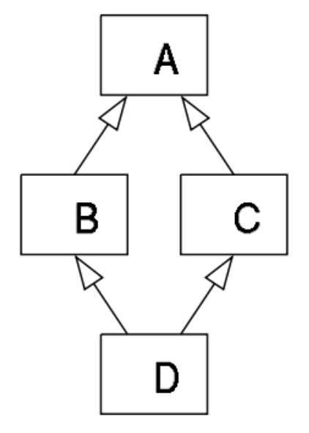
Deathly Diamond Problem
The "diamond problem" (sometimes referred to as the "deadly diamond of death") is an ambiguity that arises when two classes B and C inherit from A, and class D inherits from both B and C. If there is a method in A that B and C have overridden, and D does not override it, then which version of the method does D inherit: that of B, or that of C
Virtual inheritance solves the classic “Diamond Problem”. It ensures that the child class gets only a single instance of the common base class.
Class A
{ ... } class B: public virtual A
{
public:
void write();
}
class C: public virtual A
{
public:
void read();
}
Class D: public B, public C
{ ... }

Slide 18
“this” pointer
C++ uses a unique keyword called this to represent an object that invokes a member function.
this is a pointer that points to the object for which this function was called.
This unique pointer is automatically passed to a member function when it is called.
The Pointer this acts aa an implicit argument to all the member functions.
person & person :: greater(person & x)
(
if (x.age > age)
return x;
else
return *this;
}
we invoke this function by the call. max = A.greater(B); We can also use it to point to our class variables.
class ABC
{
int a; // this will point to this variable
int b;
int c;
void SetValue(int a,int b, int c)
{
this->a = a;
this->b = b;
this->c = c;
}
...
};

Slide 19
Virtual keyword
When we are referring to ‘virtual’ then we generally are talking about Virtual functions, Virtual Function is a function in base class, which is overrided in the derived class, and which tells the compiler to perform Late Binding on this function.
Late Binding function call is resolved at runtime, Late Binding is also called Dynamic Binding or Runtime Binding.
Virtual functions ensure that the correct function is called for an object, regardless of the type of reference (or pointer) used for function call.
Functions are declared with a virtual keyword in base class.
Rules for virtual functions
Virtual functions cannot be static and also cannot be a friend function of another class.
The prototype of virtual functions should be same in base as well as derived class.
It is not mandatory for derived class to override (or re-define the virtual function), in that case base class version of function is used.
A class may have virtual destructor but it cannot have a virtual constructor.

Slide 20
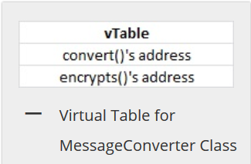
Virtual Table
vTable:
Every class that has one or more virtual member functions in it has a vTable associated with it. vTable is a kind of function pointer array that contains the addresses all virtual functions of this class. Compiler builds this vTable at compile time.
class MessageCoverter
{
int m_count;
public:
virtual std::string convert(std::string msg)
{
msg = "[START]" + msg + "[END]";
return msg;
}
virtual std::string encrypt(std::string msg)
{
return msg;
}
void displayAboutInfo()
{
std::cout<<"MessageCoverter Class"<<std::endl;
}
};

Slide 21
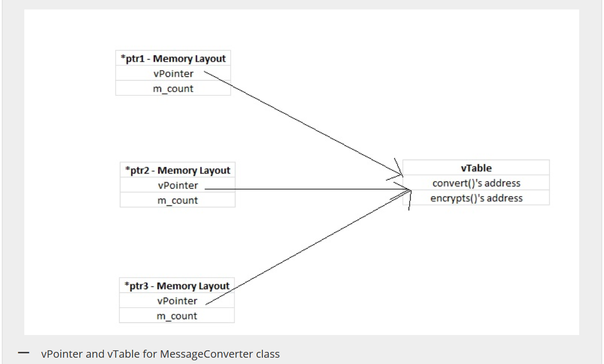
Virtual Pointer
vPointer:
Now for every object of a class that has a vTable associated with it, contains a vPointer in first 4 bytes. This vPointer points to the vTable of that class. This vPointer will be used to find the actual function address from vTable at run rime.
Note: In Every object first 4 bytes will a pointer that points to the vTable of that class. This pointer is called vPointer.
MessageCoverter * ptr1 = new MessageCoverter(); MessageCoverter * ptr2 = new MessageCoverter(); MessageCoverter * ptr3 = new MessageCoverter();

Slide 22
Virtual destructor
By making the destructor in the base class virtual, we ensure that the derived class destructor gets called before the base class destructor.
It also ensure for proper destruction of the object when the program exits. class base {
public:
base()
{ cout<<"Constructing base \n"; }
virtual ~base()
{ cout<<"Destructing base \n"; }
};
class derived: public base {
public:
derived()
{ cout<<"Constructing derived \n"; }
~derived()
{ cout<<"Destructing derived \n"; }
};
int main(void)
{
derived *d = new derived();
base *b = d;
delete b;
getchar();
return 0;
}

Slide 23
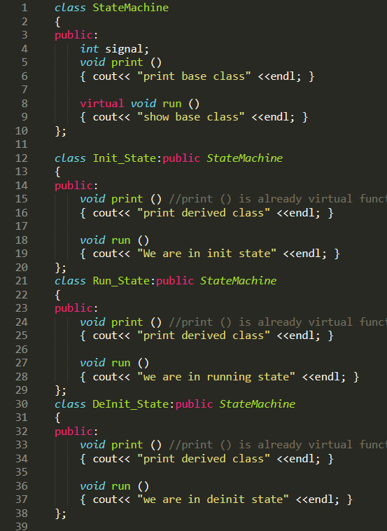
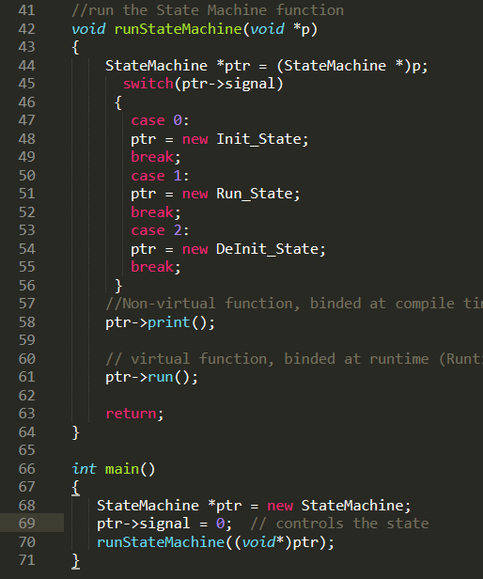
StateMachine using Runtime Polymorphism

Slide 24
Function Overloading/Compile-time Polymorphism
Function overloading means that we can use the same function name to create functions that perform a variety of different tasks. This is also known as function polymorphism in OOP
Using the concept of function overloading, we can design a family of functions with one function name but with different argument lists. // Declarations
int add(int a, int b) ; int add( int a, int b, int c); double add(double x, double y) ; double add( int p, double q); double add(double p, int q);
// Function calls
cout << add(5, 10); cout << add(15, 10.0); cout << add(12.5, 7.5); cout << add(5 , 10, 15); cout << add(0.75 , 5) ; Conditions for Function overloading
Sequence of types are argument should be different
No. of arguments may be different
Atleast a single type or multiple may be different.

Slide 25
Name Mangling in C++
Name mangling is the encoding of function and variable names into unique names so that linkers can separate common names in the language. Name mangling is commonly used to facilitate the overloading feature and visibility within different scopes. The compiler generates function names with an encoding of the types of the function arguments when the module is compiled.
int f (void) { return 1; } int f (int) { return 0; } void g (void) { int i = f(), j = f(0); }
A C++ compiler may mangle above names to following
int __f_v (void) { return 1; } int __f_i (int) { return 0; } void __g_v (void) { int i = __f_v(), j = __f_i(0); }
The extern "C" linkage specifier can also be used to prevent mangling of functions that are defined in C++ so that they can be called from C. extern "C" { int f1(int); int f2(int); int f3(int); }; This declaration tells the compiler that references to the functions f1, f2, and f3 should not be mangled.

Slide 26
Namespace and anonymous namespace
A namespace is a declarative region that provides a scope to the identifiers. It puts the variables of global scope into narrower scopes, giving them namespace scope. #include <iostream> using namespace std; namespace ns1 { int value() { return 5; } } namespace ns2 { const double x = 100; double value() { return 2*x; } } int main() {
cout << ns1::value() << '\n';// scope resolution operator used to access the namespace cout << ns2::value() << '\n'; cout << ns2::x << '\n';
return 0;
} Note: ‘using namespace ns1’ can also be used instead of scope resolution operator in value(). We can call value() directly after using declaration
Anonymous namespaces (namespace with no name). They are directly usable in the same program and are used for declaring unique identifiers. It also avoids making global static variable. namespace { int local; // use cout << local ; to see the value }

Slide 27
Scope Resolution Operator
In case of multiple Inheritance
class A
{ protected: int x; public:
A() { x = 10; }
};
class B {
protected:
int x;
public:
B() { x = 20; }
};
class C: public A, public B
{
public:
void fun()
{
cout << "A's x is " << A::x;
cout << "\nB's x is " << B::x;
}
};
To define a function outside a class.
class A {
public:
void fun();
};
// Definition outside class using ::
void A::fun()
{
cout << "fun() called";
}
To access a global variable when there is a local variable with same name
int x; // Global x
int main()
{
int x = 10; // Local x
cout << "Value of global x is " << ::x;
cout << "\nValue of local x is " << x;
return 0;
}

Slide 28
New datatypes
A Logical & Relational Expressions yield results of type bool which takes a value true or false. Relational expressions are also known as Boolean expressions. Example of relational expressions:-
x <= y
a+b == c+d
m+n > 100 Example of Logical expressions:-
a > b && x ==10
x == 10 || y == 5 Syntax:-
bool b1 = true; Note:- The default numeric value of true is 1 and false is 0 and also true, false and bool are keywords.
The wchar_t type is a wide-character literal introduced by ANSI C++ and is intended for character sets that cannot fit a character into a single byte. Wide-character literals begin with the letter L.
wchar_t is usually 2 bytes in size, it can be used to represent text in any 2-byte encoding so it can only represent Unicode in a variable-width encoding (usually UTF-16).
L'ab' // wide-character constant

Slide 29
Pure functions
Pure functions are quite similar to mathematical functions. A function is called pure function if it always returns the same result for same argument values and it has no side effects like modifying an argument (or global variable) or outputting something. [[gnu::pure]] int square(int x); int main(int argc, char *argv[]) { auto x = square(argc); auto y = square(argc); // second function call will not occur in corresponding assembly code return x+y; }
Equivalent assembly code :-
main:
sub rsp, 8
call square(int)
add rsp, 8
add eax, eax
ret

Slide 30
Memory Management in C and C++
There are a number of problems with dynamic memory allocation in C specially for a real time system.
The standard library functions (malloc() and free()) are problematic in a multithreaded application. Without great care, it is easy to introduce memory leaks into application code implemented using malloc() and free(). This is caused by memory being allocated and never being deallocated. There is an issue of memory fragmentation also. new is a kind of "type-aware" version of malloc: the type of the expression "new int" is "int*". no cast is required when using new. The basic new and delete operators are intended to allocate only a single object at a time. int *p = new int ; float *q = new float ;
*p = 25; *q = 7.5; new[] and delete[] can be used to create a memory space for dynamically allocated arrays. int *p = new int[10]; delete[] p; Lifetime:-
A data object created inside a block with new, will remain in existence until it is explicitly destroyed by using delete. Thus, the Lifetime of an object is directly under our control and is unrelated to the block structure of the program

Slide 31
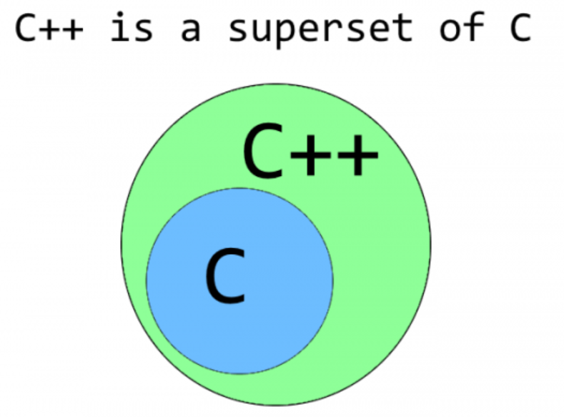
Difference between C and C++
C follows the procedural programming paradigm while C++ is a multi-paradigm language(procedural as well as object oriented).
In case of C, the data is not secured while the data is secured(hidden) in C++
C is a low-level language while C++ is a middle-level language.
C uses the top-down approach while C++ uses the bottom-up approach.
C++ supports function overloading while C does not
Note: The standard input & output functions differ in the two languages. C++ uses a convenient abstraction called streams to perform input and output operations in sequential media such as the screen, the keyboard or a file. A stream is an entity where a program can either insert or extract characters to/from.
the standard output by default is the screen, and the C++ stream object defined to access it is cout, cout is used together with the insertion operator, which is written as <<.
i.e:-
cout << 100;
the standard input by default is the keyboard, and the C++ stream object defined to access it is cin,
cin is used together with the extraction operator, which is written as >>. i.e:-
int age;
cin >> age;

Slide 32
Undefined behaviour in C and C++
Use of an uninitialized variable: A very common mistake is to not initialize the variables that serve as counters to 0. You add values to them, but since the initial value is garbage
Signed integer overflow: If arithmetic on an 'int' type (for example) overflows, the result is undefined. One example is that "INT_MAX+1" is not guaranteed to be INT_MIN.
Oversized Shift Amounts: Shifting a uint32_t by 32 or more bits is undefined.
Dereferences of Wild Pointers and Out of Bounds Array Accesses: Dereferencing random pointers (like NULL, pointers to free'd memory, etc) and the special case of accessing an array out of bounds is a common bug in C applications
Dereferencing a NULL Pointer: Contrary to popular belief, dereferencing a null pointer in C is undefined. It is not defined to trap
Violating Type Rules: It is undefined behaviour to cast an int* to a float* and dereference it

